Slide 1
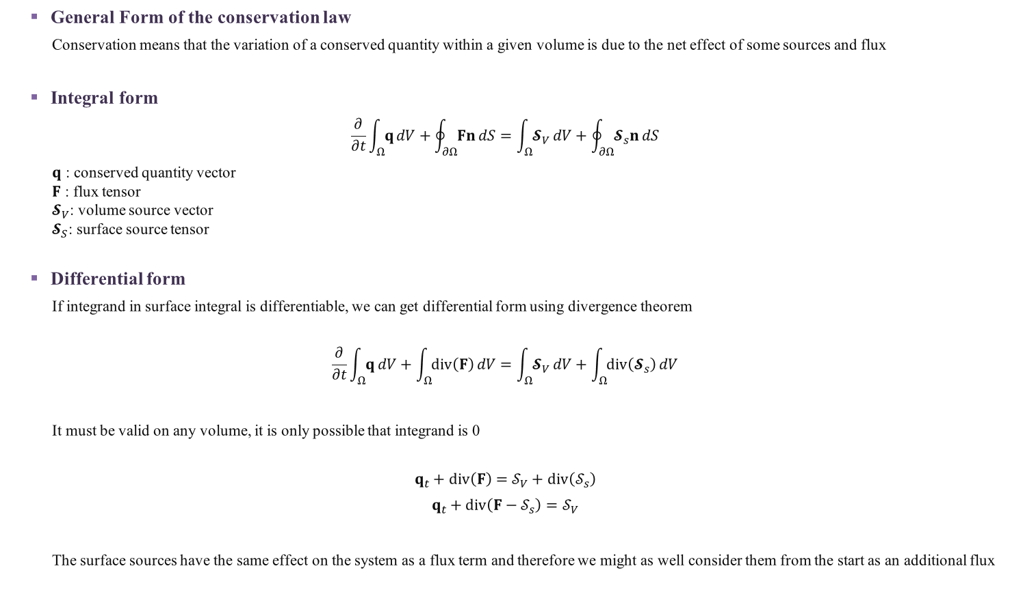
Conservation Laws
General Form of the conservation law
Conservation means that the variation of a conserved quantity within a given volume is due to the net effect of some sources and flux
Integral form
$$\frac{∂}{∂t}\int_{Ω}{q}dV+\oint_{∂Ω}{Fn}dS=\int_{Ω}{𝓢_{V}}dV+\oint_{∂Ω}{𝓢_{s}n}dS$$
$q$ : conserved quantity vector
$F$ : flux tensor
$𝓢_{V}$: volume source vector
$𝓢_{S}$: surface source tensor
Differential form
If integrand in surface integral is differentiable, we can get differential form using divergence theorem
$$\frac{∂}{∂t}\int_{Ω}{q}dV+\int_{Ω}{div\left(F\right)}dV=\int_{Ω}{𝓢_{V}}dV+\int_{Ω}{div\left(𝓢_{s}\right)}dV$$
It must be valid on any volume, it is only possible that integrand is 0
$$q_{t}+div\left(F\right)=𝒮_{V}+div\left(𝒮_{s}\right)$$
$$q_{t}+div\left(F−𝒮_{s}\right)=𝒮_{V}$$
The surface sources have the same effect on the system as a flux term and therefore we might as well consider them from the start as an additional flux
Notes:
[Hirsch C.]Numerical Computation of Internal and External Flows.Volume1-Fundamentals of Computational Fluid Dynamics 50p

